Slide 1

Welcome Parents!

Slide 2
FIRST
Our mission is to inspire young people to be science and technology leaders, by engaging them in exciting mentor-based programs that build science, engineering and technology skills, that inspire innovation, and that foster well-rounded life capabilities including self-confidence, communication, and leadership.

Slide 3
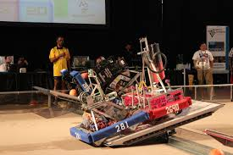
Our team goals
Generate interest in Science, Technology, Engineering, and Math related fields.
Give students the opportunity to fail, learn from their mistakes, then succeed.
Build skills in:
  Design
  Fabrication
  Team work
  Communication
  Fundraising
  Problem Solving
  Media
  Etc

Slide 4
How it all works
We design and build a robot to play a game.
The Game
  2 min 30 sec
  Randomly picked “alliances” for qualifying rounds
  Top 8 selects their team for elimination rounds.
Build season
  6 weeks from the kickoff (Jan 4, 2014)
  We are in week 2

Slide 5
How it all works
Schedule:
  Mon-Thurs – before/during/afterschool 3-5pm
  Saturdays 9-1:30 ish
  We will extend times as necessary to complete the build.

Slide 6
What should my student be doing?
Students should contribute in areas that peak their interest, but also contribute to the team.
4 main teams
CAD, Programming, Construction, and BOMAN

Slide 7
CAD
Responsible for the design of the robot
Will work with construction team to communicate design to facilitate construction.
Update CAD file as necessary
Provide renderings/documentation/presentation items for our robot.
Teach “rookies” CAD

Slide 8
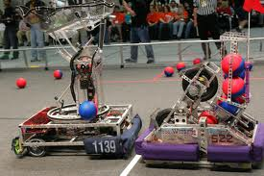
Programming
Responsible for:
  Understanding functions of the robot/coordinate with drivers
  Research
  Write code for robot
  Wire robot
  Troubleshoot
  Teach “rookies” programming

Slide 9
Construction
Fabrication of Robot structure, Game pieces, and any thing else we need built
Pit design and construction
Certify “rookies” on equipment

Slide 10
BOWMAN
Business- Create a budget and a plan for fundraising and execute
Outreach- plan events to give back to the community, also to spread the word about our team and FIRST
Media-update Facebook, Website, Video,etc
Awards – Award submission for our team as well as assist our seniors in scholarship applications
Networking- Network with other teams, Help other teams, etc

Slide 11
Students
Should find their place and get involved.
The more they get involved, the more they will get out of the program.
Help the team with BOMAN activities

Slide 12

The game
http://www.youtube.com/watch?v=oxp4dkMQ1Vo

Slide 13
This years competitions
Arkansas Regional – March 5-8 in Searcy, AR
St. Louis Regional – March 13-15 at Chafeitz.
  Students will sign up to go to AR
  Students responsible for lodging/meals, etc

Slide 14
Parents
There are ways you can get involved!
  Come up and work with the students/Mentor
  Help with snacks/lunches
  Make connections for our team
  Other skills that can be used for the team
  Chaperone AR trip

Slide 15
My Contact info
Stephenbeauchamp@claytonschools.net
314-854-6080

